Slide 1
What is your call?
Mark 3:1-19
Preached for Dr. Rick Griffith, Singapore Bible College www.biblestudydownloads.com

Slide 2
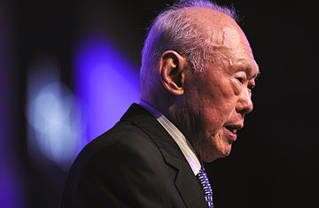
The greatest fortune-teller??

Slide 3
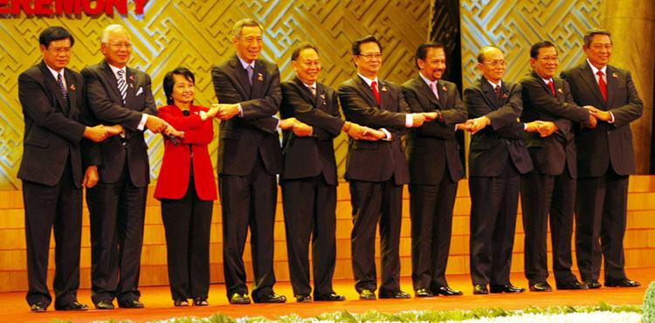
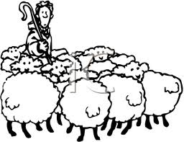

Slide 4
Question to consider: How do you respond to Jesus your Master who has called you to ministry in your daily life?

Slide 5
In the first two chapters:
Jesus has been baptized,
has begun his ministry to proclaim the gospel,
has called the disciples,
has gone throughout Galilee to preach in the synagogues and to cast out demons,
has healed many people in 4 different accounts…

Slide 6
In the first two chapters:
Jesus has been baptized,
has begun his ministry to proclaim the gospel,
has called the disciples,
has gone throughout Galilee to preach in the synagogues and to cast out demons,
has healed many people in 4 different accounts…
Gradually and increasingly
Revealed His identity challenged their responses

Slide 7
Different Responses:
4 disciples immediately followed him (1:20)
They were astonished at his teaching (1:22)
His fame spread everywhere through Galilee (1:28)
“Everyone is looking for you” (1:37)
Jesus could no longer openly enter a town (1:45)
They were all amazed and glorified God (2:12)
And all the crowd was coming to him (2:13)
Levi and many followed him (2:15)
The Pharisees began to ask him questions (2:16-28)

Slide 8
Mark 3:1-19: 4 types of responses to Jesus
Also for you to decide: How will you respond to Jesus?

Slide 9
Mark 3:1-6
Again he entered the synagogue, and a man was there with a withered hand. And they (the Pharisees) watched Jesus, to see whether he would heal him on the Sabbath, so that they might accuse him. And he said to the man with the withered hand, "Come here.“ And he said to them, "Is it lawful on the Sabbath to do good or to do harm, to save life or to kill?" But they were silent. And he looked around at them with anger, grieved at their hardness of heart, and said to the man, "Stretch out your hand." He stretched it out, and his hand was restored. The Pharisees went out and immediately held counsel with the Herodians against him, how to destroy him.

Slide 10
(1) Jesus
Again he entered the synagogue, and a man was there with a withered hand. And they watched Jesus, to see whether he would heal him on the Sabbath, so that they might accuse him. And he said to the man with the withered hand, "Come here.“ And he said to them, "Is it lawful on the Sabbath to do good or to do harm, to save life or to kill?" But they were silent. And he looked around at them with anger, grieved at their hardness of heart, and said to the man, "Stretch out your hand." He stretched it out, and his hand was restored. The Pharisees went out and immediately held counsel with the Herodians against him, how to destroy him.

Slide 11
(2) The sick man
Again he entered the synagogue, and a man was there with a withered hand. And they watched Jesus, to see whether he would heal him on the Sabbath, so that they might accuse him. And he said to the man with the withered hand, "Come here.“ And he said to them, "Is it lawful on the Sabbath to do good or to do harm, to save life or to kill?" But they were silent. And he looked around at them with anger, grieved at their hardness of heart, and said to the man, "Stretch out your hand." He stretched it out, and his hand was restored. The Pharisees went out and immediately held counsel with the Herodians against him, how to destroy him.

Slide 12
(3) The Pharisees & Co.
Again he entered the synagogue, and a man was there with a withered hand. And they watched Jesus, to see whether he would heal him on the Sabbath, so that they might accuse him. And he said to the man with the withered hand, "Come here.“ And he said to them, "Is it lawful on the Sabbath to do good or to do harm, to save life or to kill?" But they were silent. And he looked around at them with anger, grieved at their hardness of heart, and said to the man, "Stretch out your hand." He stretched it out, and his hand was restored. The Pharisees went out and immediately held counsel with the Herodians against him, how to destroy him.

Slide 13
Mark 3:1-6
Again he entered the synagogue, and a man was there with a withered hand. And they watched Jesus, to see whether he would heal him on the Sabbath, so that they might accuse him. And he said to the man with the withered hand, "Come here.“ And he said to them, "Is it lawful on the Sabbath to do good or to do harm, to save life or to kill?" But they were silent. And he looked around at them with anger, grieved at their hardness of heart, and said to the man, "Stretch out your hand." He stretched it out, and his hand was restored. The Pharisees went out and immediately held counsel with the Herodians against him, how to destroy him.

Slide 14
Do you respond to Jesus like the Pharisees? Are you stubborn and hardhearted towards Jesus’ challenge?

Slide 15
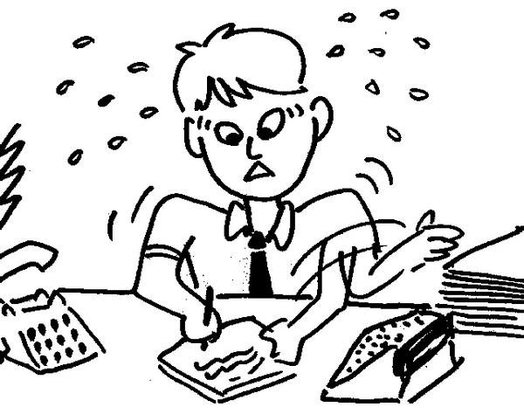

Slide 16
Do you respond to Jesus like the Pharisees? Are you stubborn and hardhearted towards Jesus’ challenge?

Slide 17
Mark 3:7-10
Jesus withdrew with his disciples to the sea, and a great crowd followed, from Galilee and Judea and Jerusalem and Idumea and from beyond the Jordan and from around Tyre and Sidon. When the great crowd heard all that he was doing, they came to him. And he told his disciples to have a boat ready for him because of the crowd, lest they crush him, for he had healed many, so that all who had diseases pressed around him to touch him.

Slide 18
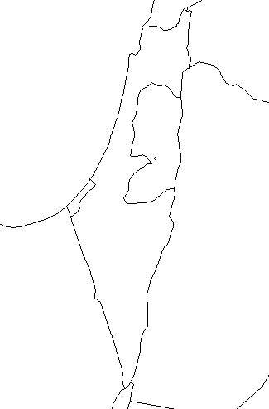
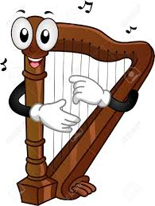
“Heal me!”
Tyre & Sidon
“Heal me!”
Galilee
Beyond Jordon
Jerusalem
Judea
“Heal me!”
“Heal me!”
Idumea

Slide 19
Mark 3:7-10
Jesus withdrew with his disciples to the sea, and a great crowd followed, from Galilee and Judea and Jerusalem and Idumea and from beyond the Jordan and from around Tyre and Sidon. When the great crowd heard all that he was doing, they came to him. And he told his disciples to have a boat ready for him because of the crowd, lest they crush him, for he had healed many, so that all who had diseases pressed around him to touch him.

Slide 20
Do you respond to Jesus like the crowd? Do you “crush” Jesus to meet your felt needs?

Slide 21
A. provision of money
B. time-management
C. children
D. good grades
E. future direction
D’. reasonable lecturers
C’. life partners
B’. health
A’. church support

Slide 22
Do you respond to Jesus like the crowd? Do you "crush" Jesus to meet your felt needs?

Slide 23
Mark 3:11-12
And whenever the unclean spirits saw him, they fell down before him and cried out, "You are the Son of God.“ And he strictly ordered them not to make him known.

Slide 24
Mark 3:11-12
And whenever the unclean spirits saw him, they fell down before him and cried out, "You are the Son of God.“ And he strictly ordered them not to make him known.
People asked to keep quiet:
1:44, 5:43, 9:9
Son of God:
- suffer, rejected, mocked, delivered, killed, condemned (8:31, 9:30, 10:33)
- came to serve, and to give his life as a ransom for many (10:45)

Slide 25
Do you respond to Jesus like the demons? Do you only profess in orthodox teaching? Are you also committed to suffer and serve like Jesus?

Slide 26
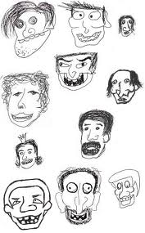
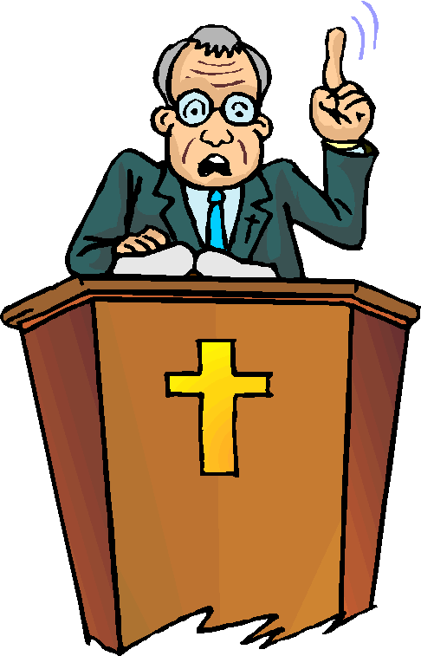

Slide 27
(1) The Pharisees (2) The crowd (3) The demons (4) … The twelve apostles

Slide 28
Mark 3:13-19
And he went up on the mountain and called to him those whom he desired, and they came to him. And he appointed twelve (whom he also named apostles) so that they might be with him and he might send them out to preach and have authority to cast out demons. He appointed the twelve: Simon (to whom he gave the name Peter); James the son of Zebedee and John the brother of James (to whom he gave the name Boanerges, that is, Sons of Thunder); Andrew, and Philip, and Bartholomew, and Matthew, and Thomas, and James the son of Alphaeus, and Thaddaeus, and Simon the Zealot, and Judas Iscariot, who betrayed him.

Slide 29
Mark 1:35-39
And rising very early in the morning, while it was still dark, he departed and went out to a desolate place, and there he prayed. And Simon and those who were with him search for him, and they found him and said to him, “Everyone is looking for you.” And he said to them, “Let us go on to the next towns, that I may preach there also, for that is why I came out.” And he went throughout all Galilee, preaching in their synagogues and casting out demons.

Slide 30
Mark 3:13-19
And he went up on the mountain and called to him those whom he desired, and they came to him. And he appointed twelve (whom he also named apostles) so that they might be with him and he might send them out to preach and have authority to cast out demons. He appointed the twelve: Simon (to whom he gave the name Peter); James the son of Zebedee and John the brother of James (to whom he gave the name Boanerges, that is, Sons of Thunder); Andrew, and Philip, and Bartholomew, and Matthew, and Thomas, and James the son of Alphaeus, and Thaddaeus, and Simon the Zealot, and Judas Iscariot, who betrayed him.

Slide 31
Do you respond to Jesus like the apostles? Have you become a Christ-like follower?

Slide 32
How do you respond to Jesus your Master in your daily life? :
Stubborn towards His challenges?
Merely to meet you felt needs?
Professing orthodox teaching without commitment?
Become a Christ-like follower?

Slide 33
God has called you to ministry. It is now our call to follow Him daily.

Slide 34
Black

Slide 35
NT Sermons link at biblestudydownloads.com
Get this presentation and script for free!

